Slide 1





The Impact of Changing Economic Conditions Since 2005 on the Forest Sector
Richard W. Guldin and W. Brad Smith
U.S. Forest Service Research & Development
Washington, DC
National Capital SAF Chapter Meeting, February 2012

Slide 2
Introduction
Changing economic conditions since 2005 have had wide-ranging impacts throughout the economy
In the January issue of The Forestry Source, we summarized the impacts of the changing economic conditions on the forest sector, limiting our analysis to jobs in the woods and at primary production facilities
Since then, in response to many comments and questions, we’ve taken two additional steps:
  Three regional analyses are in progress. More details on impacts at the region and State level. Results will be reported in a couple of months—a special issue of Forest Products Journal and highlights in The Forestry Source
  We’ve extended our national analysis to include key secondary manufacturing sub-sectors and we’re reporting those impacts today

Slide 3
Data Sources
Forest Service Research & Development
  Forest Inventory & Analysis (FIA) program
  Forest Products Laboratory’s economics & statistics unit
Department of Commerce
  Census Bureau
  Bureau of Economic Analysis
Federal Reserve Bank of St. Louis
Department of Labor
What’s new is the sector-specific analyses our researchers have been able to do with the data assembled

Slide 4
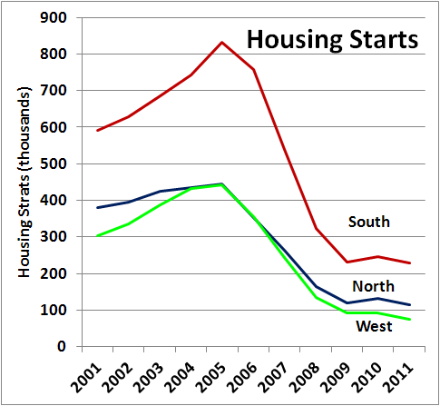
The main events
Number of primary wood processing mills
by region, 1990 - 2009
-
12,000
Number of mills
10,000
US total
8,000
6,000
North
4,000
South
2,000
West
0
1990
1995
2000
2005
2009
Source: Census Bureau
Source: Forest Inventory and Analysis
The number of annual U.S. single-family housing starts plummeted 75% from 2005 through 2009
The number of primary mills has declined steadily for over 50 years
Since 2005, over 1,000 mills closed
Overall sawmilling capacity was reduced by 15%. Today, production is 50% or less of capacity at many of the remaining mills
Notes:
Housing starts down 75% from 2005 to 2009; sector % of total GDP falling

Slide 5
Forestry related job losses continued to mount through 2010
Employment trends in forestry and
related sectors, 2001-2011
1,200
Thousand jobs
1,000
Residential
construction
800
Furniture and
related product
600
manufacturing
Furniture and
Paper
home stores
400
manufacturing
Wood
200
manufacturing
Source: U.S. Department of Labor, Bureau of Labor Statistics
Forestry and
-
logging
2001
2003
2005
2007
2009
2011
Notes:
Our Forestry Source article placed primary forestry sector job losses from 2005 to 2009 at 294,000. This number swelled to 322,805 by the end of 2010.
Additional job losses in related sectors such as furniture manufacture residential construction and furniture retail were 735,767 from 2005 to 2010 - bringing job losses forestry related sectors to 1.1 million! This does not even address peripheral losses in areas such as transportation, energy, printing and so forth.
And, of course, this resulted in a reduction in annual shipments of $57 billion since the peak year of 2006.
Wage losses in primary forestry and furniture manufacture averaged $14 billion annually since 2006.

Slide 6
Production and consumption began to rebound in 2010 while imports remained down
Source: U.S. Forest Products Laboratory and Forest Inventory & Analysis
Notes:
Lumber production hit the lowest level since 1981 in 2009 and you would have to go back to the early late 1950s for this level to be normal annual production. The early 80s was a milder recession than the current one.
While pulpwood production remained relatively stable during the recession, it had declined sharply in the late 1990s and today, like lumber, is at a 30 year production low. Both sectors slightly up in 2010.
Non-residential wood for energy in 2010 was only down 6% from average production of the last 20 years. Industrial use was the primary gain area.
Overall consumption of wood in the U.S. plummeted since 2005 with a slight uptick in 2010. Exports have been steady but imports are down dramatically (62%) from the 2005 high.

Slide 7
Summary of the situation 2005-2010
Annual single-family housing starts plummeted 75% since 2005
1.1 million jobs lost in forestry and related sectors
  Estimated $25+ billion annual loss of wages
  Reduced annual shipments of $57+ billion
Over 1,000 mills have closed since 2005 and more are threatened
  Most surviving mills are operating well below capacity
Overall production and consumption at lowest levels since 1960s
  Pulpwood & lumber production at lowest levels in 30+ years
Harvest acres on private forest land is down nearly 40%

Slide 8
Encouraging signals emerging
Forestry and related sector job losses have slowed
The number of single-family housing starts remains low but stable
Multi-family housing starts up sharply
2010 showed an increase in wood related production and shipments
Wood use for nonresidential energy is only 6% below 20-year average levels
Overall industrial GDP is rising and the trade balance in combined pulp, paper and sawmill products is up from -$11.7 billion in 2005 to +$1.3 billion in 2010 with prospects for further improvement
Source: International Trade Association (ITA)

Slide 9
Closing Thoughts
If low annual harvest rates on private lands (40% below 2005) continue for some years, growing stock volumes and stand densities will increase
  Significant forest health issues could emerge
  Low harvest levels means lower income for private landowners, which could affect land use decisions
Because the remaining mills are operating well under their capacity, when demand picks up, existing mills can boost production; few closed mills are likely to reopen
Secondary impacts on communities of mills closing (e.g., loss of jobs in firms servicing the mill and transportation) means the true community impact of mill closures is larger than reported he

